Slide 1

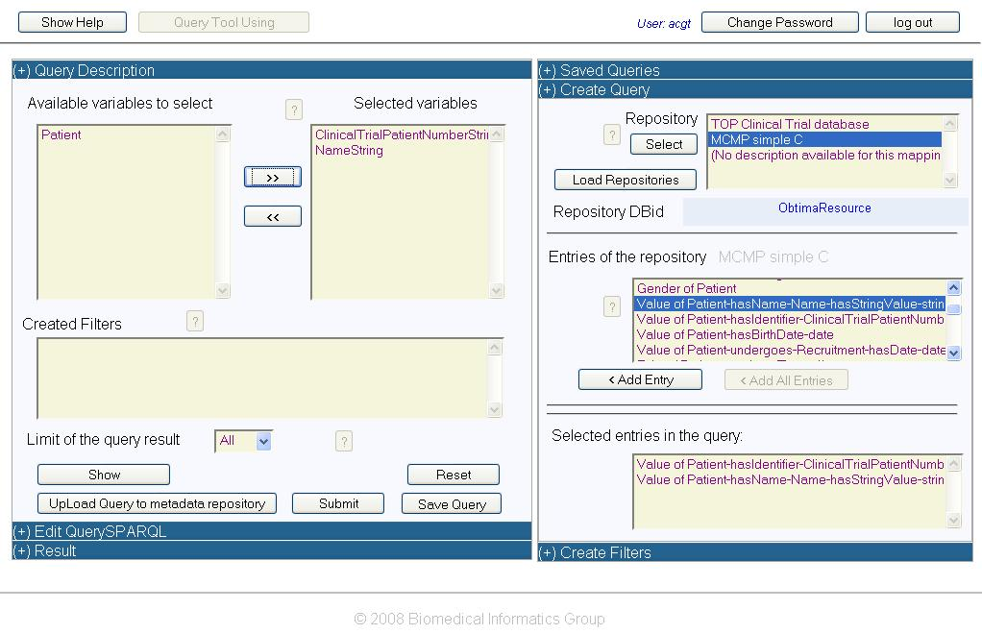
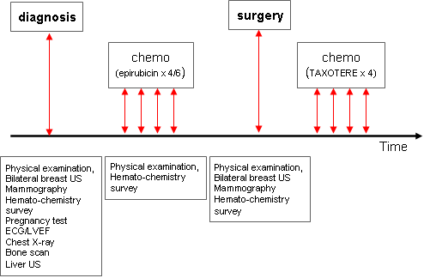
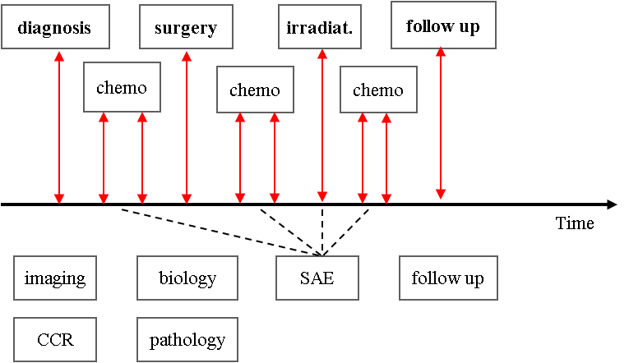

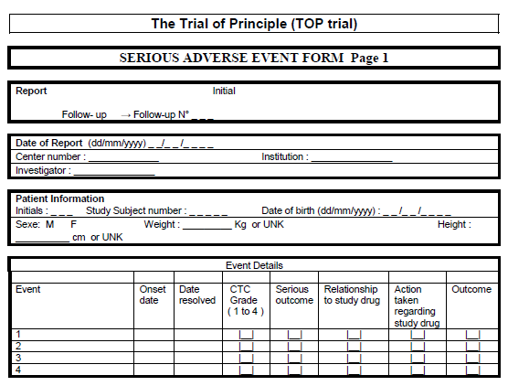
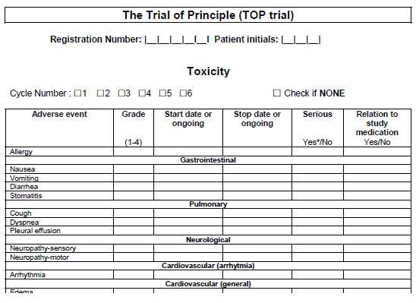
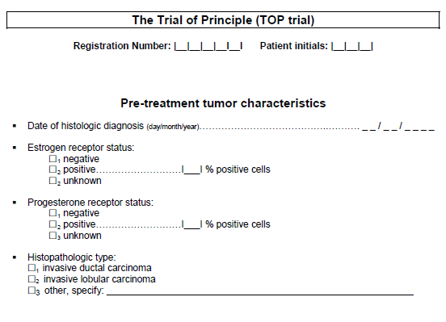
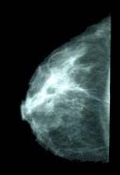
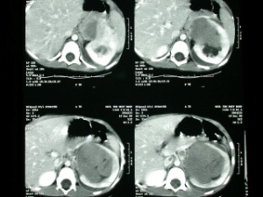

Data Integration Architecture
Introduction
Client Tools / End Users
ACGT provides users with transparent access to heterogeneous, disparate sources of information, including clinical trial, genetic, and image databases related to patients involved in clinical trials.
The two main components providing this functionality are the Data Access Services and the Semantic Mediator.
The Data Access Services resolve syntactic heterogeneities whereas the Semantic Mediator resolves the semantic heterogeneities.
The semantic integration process is backed up by the ACGT Master Ontology, describing the domain of clinical trials on cancer. The Data Integration layer relies on the GAS Security Framework to guarantee restricted access to sensitive data as well as secure communications.
GAS
Security
Framework
Semantic
Mediation
Layer
ACGT
Master
Ontology
Mapping Tool
Query Tool
Semantic Mediator Core
Wrappers
Layer
DMS
Credential
Database
Query
component
Source ontology interface
Delivery
component
Clinical
Report
Forms
Imaging
PACS
Microarrays
Dynamic
Relational databases
Clinical trial data
Analysis data
The ACGT Query Tool
Data Access Services
Main Responsibilities
Support of a uniform mechanism for querying data. Data can be queried using SPARQL, thus hiding the different query mechanisms.
Export of the schema of data resources. An RDF Schema of a data resource is provided.
Retrieval and delivery of files. Large files in standardized formats can be retrieved and delivered to specified locations (amongst others DMS).
Credential-based authentication and authorization. The ACGT security infrastructure is used to control access to the data.
Dynamic deployment of new data resources. To speed-up integration of new data resources, integration into the ACGT infrastructure can be carried out by the owner of the database using the ACGT web portal.
Main Features
Offering an easy entry point to the ACGT Semantic Mediation layer. Graphical interface for users lacking advanced technical background to submit queries.
Hiding the SPARQL complexity. The SPARQL query language requires specific knowledge of RDF and OWL. The Query Tool hides this complexity by allowing the creation of queries with natural language elements.
Queries for workflows. Queries created in this tool can be later employed in advanced workflows involving access and analysis of data.
Conclusions
TOP trial
SIOP trial
We successfully showed that the devised data access layer and tools allow the end-user to transparently access heterogeneous, disparate, distributed sources of information as if it were a single source, whilst ensuring strict access control.
In addition, an array of tools, formats, protocols and procedures has been developed to support the semantic integration of clinical trials in the ACGT platform.
Imaging
PACS
Microarrays
CRF’s

