Slide 1


Cancer Multi-scale Modeling and the ACGT Oncosimulator
Georgios Stamatakos
In Silico Oncology Group
Institute of Communication and Computer Systems
School of Electrical and Computer Engineering
National Technical University of Athens

Slide 2
ACKNOWLEDGMENTS
D.Dionysiou - ICCS, Nat.Technical University of Athens
N. Graf - University of Saarland
E.Georgiadi – ICCS, Nat.Technical University of Athens
E. Kolokotroni - ICCS, Nat.Technical University of Athens
S. Giatili - ICCS, Nat.Technical University of Athens
A. Hoppe, University of Saarland
A. Lunzer - Hokkaido University
Y. Tanaka- Hokkaido University
R. Belleman, - University of Amsterdam
P. Melis - University of Amsterdam
J. Jacques – INRIA
M. Erdt – Fraunhofer (FhG)
J. Pukacki - PSNC
N. Uzunoglu - ICCS, Nat.Technical University of Athens
C. Desmedt, Institut Jules Bordet
G. Sakas – Fraunhofer Institute
I. Sachpazidis – Fraunhofer Institute
M. Grimm – Fraunhofer Institute
K. Marias - Foundation for Research and Technology - Hellas
M. Tsiknakis – Foundation for Research and Technology – Hellas
and Many Others

Slide 3
CANCER MULTI-SCALE MODELING

Slide 4
INTRODUCTION
Research work to model cancer from the basic science perspective.
Bottom-up integration of multiscale information:
  insight into the biomechanisms constituting the natural phenomenon of cancer
  formulating new candidate generic cancer treatment strategies

Slide 5
Multiscale cancer modelling has also potential to support cancer treatment planning optimization in the patient individualized context.
Top-down clinically oriented modelling approach gaining ground.
  method developed by the In Silico Oncology Group - ISOG (www.in-silico-oncology.iccs.ntua.gr)
  the approach is based on discrete event/state simulation

Slide 6
Several simulation models oriented towards patient individualized treatment optimization developed
Emerging simulators serve as the core simulation modules (Oncosimulators) of both the EC funded research projects ACGT and ContraCancrum
Brief outline of the basics of the approach along with paradigmal results demonstrating the effect of symmetric (and asymmetric) division of cancer stem cells on the cellular constitution of a tumour
Potential and extensibility of the models discussed

Slide 7
overview of the top-down multiscale cancer simulator

Slide 8
Fig.1 Information flow diagram of a multiscale Oncosimulator

Slide 9
Some basic features
  use of a cubic discretization mesh superimposed onto the anatomic region of interest
  grouping of the biological cells lying within each geometrical cell of the mesh into equivalence classes
  eventual discrimination between the poorly and well oxygenated regions of the tumour based on the imaging data available
  consideration of pertinent cytokinetic models
  satisfaction of mechanical laws
  cell killing probability according to pharmacology and/or radiobiology or other pertinent disciplines

Slide 10
Practical issues
  convergence and sensitivity studies of the model have revealed intervals of applicability
  Biopsy material and/or blood can provide a number of critical molecular and histological markers
  These in turn, following an appropriate interdependence analysis, can lead to the estimation of the treatment induced cell kill probability for a single cell of a given proliferative potential category (e.g. stem, progenitor, differentiated) and proliferation phase (e.g. G1, S, G2, Mitosis, G0) for a given radiation dose or pharmacological area under curve (AUC)

Slide 11
  In order to achieve a pragmatic “biocomplexity level jumping” and integration the “summarize and jump” strategy has been applied (Fig.2)

Slide 12
Fig.2 A. An example of the “summarize and jump” strategy as applied to the case of tumour response to teatment modelling in the clinical setting. Only three (clusters of) levels are depicted for simplification purposes.

Slide 13
Special features of the simulation models
One of the central features of the latest versions of the model is the explicit distinction of proliferating cells in stem and progenitor (i.e. LImited Mitotic Potential or limp) cells as well as terminally differentiated cells.
In the special case of breast cancer such a modeling approach is in accordance with the fact that breast cancer tumours have been shown to contain mammary stem cells.

Slide 14
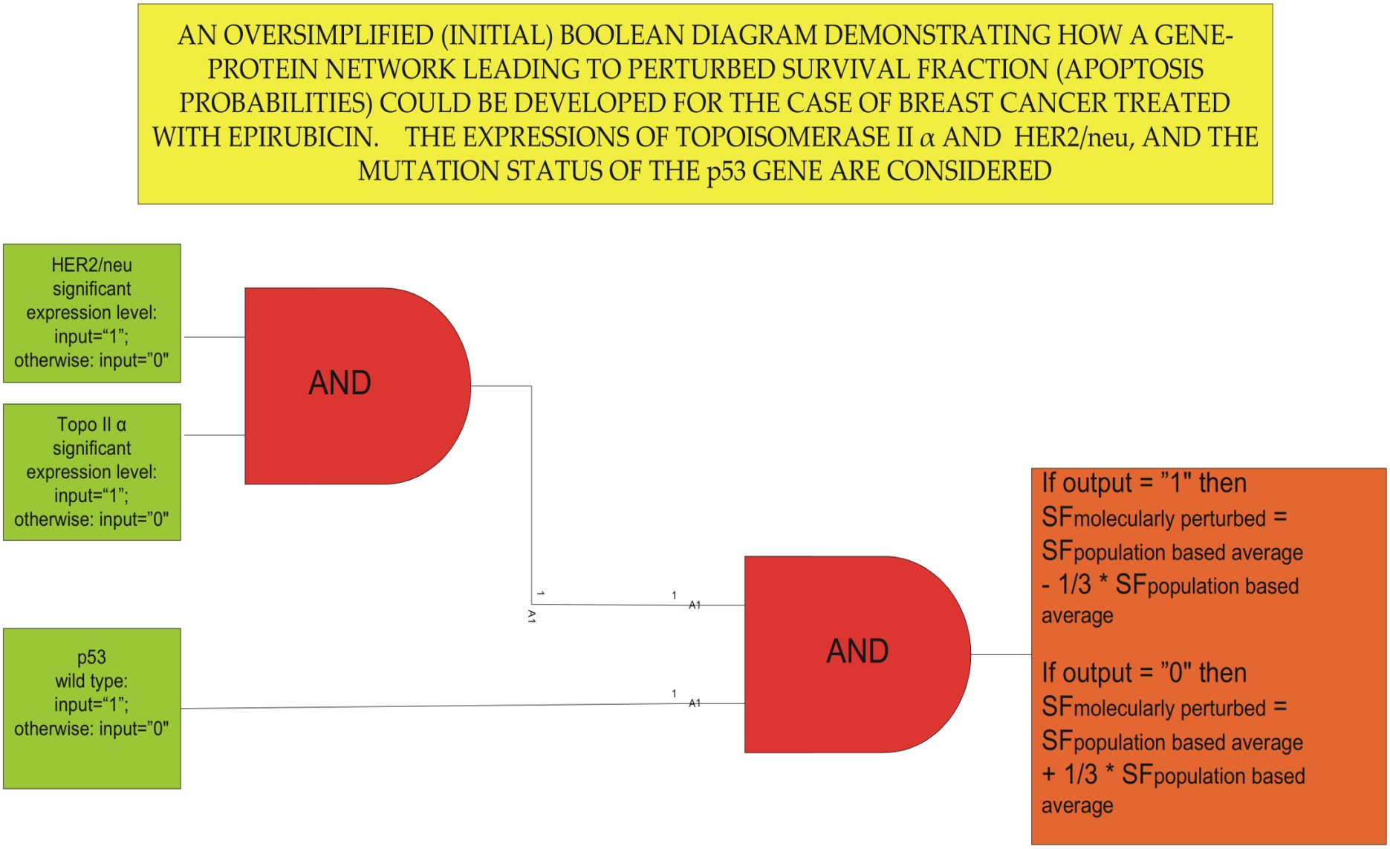
A TENTATIVE OVERSIMPLIFIED MOLECULAR NETWORK FOR THE TOP TRIAL TO BE USED FOR THE ACGT ONCOSIMULATOR
Based on textual info in S.H.Giordano, The Oncologist, vol.8, pp.521-530,2003

Slide 15
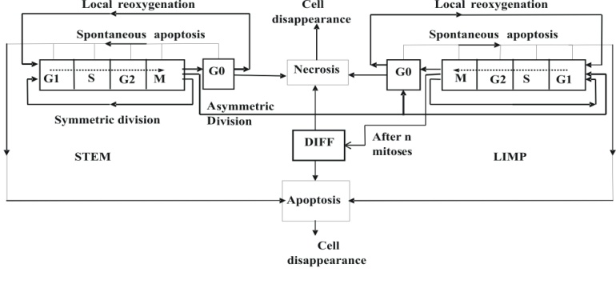
Fig 3. A generic cytokinetic model for free tumour growth. STEM: stem cells. LIMP: Limited proliferative potential cells. DIFF: terminally differentiated cells

Slide 16
Indicative Results

Slide 17
A. EXAMPLES OF EARLIER VERSIONS OF MULTISCALE CANCER MODELING

Slide 18
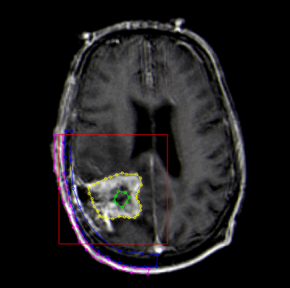
An MRI slice depicting a glioblastoma mutiforme tumour. Both the clinical volume of the tumour and its central necrotic area have been delineated. The present case has been considered for the preliminary checks of the simulation model.
[G.Stamatakos, D.Dionysiou, E.Zacharaki, N.Mouravliansky, K.Nikita, and N.Uzunoglu, "In Silico Radiation Oncology: Combining Novel Simulation Algorithms with Current Visualization Techniques,'' Proc. IEEE, Special Issue on "Bioinformatics: Advances and Challenges" Vol.90, No.11, November 2002, pp.1764-1777]

Slide 19
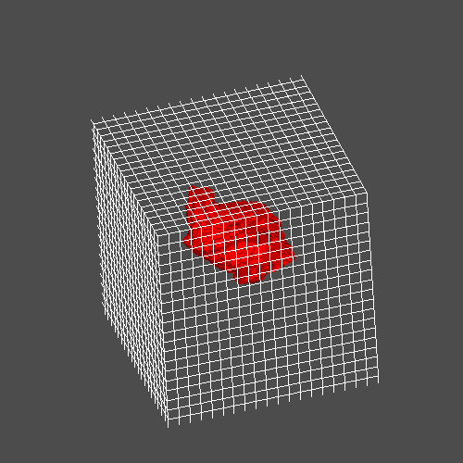
Spatial discretization

Slide 20
Mesh Initialization
NBC
Equivalence Classes

Slide 21
Cytokinetic model
SA or RI-ID
RI-MAD
RI-MND
M
G₀
G₁
S
G₂
N
A
Cell disappearance
The probabilities of the alternative “death paths” due to irradiation depend primarily on the type of tumour cell.
In GBM the vast majority of cells undergoes a mitotic necrotic death.
SA: Spontaneous Apoptosis, RI-ID: Radiation-Induced Interphase Death, RI-MAD: Radiation-Induced Mitotic Apoptotic Death, RI-MND: Radiation-Induced Mitotic Necrotic Death

Slide 22
PROLIFERATING CELL
G₀- CELL
Irradiation (α_{P},β_{P} ) (α_{S},β_{S} )
Irradiation (α_{G0},β_{G0} )
LQ cell hit
LQ cell survival
LQ cell hit
LQ cell survival
Cell still cycling for a few (e.g. 3) cell cycles
Cell is gradually disintegrating
YES
NO
Is oxygen and nutrient supply still adequate?
Has oxygen and nutrient supply become adequate?
NO
YES
Cell lysis/apoptosis
Cell death products are diffused
Cell disappearance ⇒ Tumor shrinkage
Simplified flow chart for the response of a single tumour cell to irradiation. Symbol explanation: α_{P} and β_{P} stand for the α and β parameters of the linear quadratic model for the tumour proliferating cells excluding those in phase S. The subscript S denotes cells in the DNA synthesis phase, whereas the subscript G0 denotes cells in the resting (dormant) phase G0.
[from G.Stamatakos, D.Dionysiou, E.Zacharaki, N.Mouravliansky, K.Nikita, and N.Uzunoglu, "In Silico Radiation Oncology: Combining Novel Simulation Algorithms with Current Visualization Techniques,'' Proc. IEEE, Special Issue on "Bioinformatics: Advances and Challenges" Vol.90, No.11, November 2002, pp.1764-1777]

Slide 23
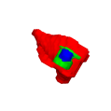
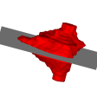
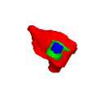
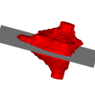
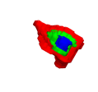

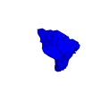
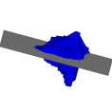
Irradiation according to the standard fractionation scheme
(2 Gy once a day, 5 days per week, 60 Gy in total). Left panel: three dimensional sections of the tumour shown in the right panel: (a) before the beginning of irradiation, (b) 1 fictitious day after the beginning of irradiation, (c) 2 fictitious days after the beginning of irradiation and (d) 3 fictitious days after the beginning of irradiation. Colour code red: proliferating cell layer, green: dormant cell layer (G0), blue: dead cell layer. The colouring criterion “99.8%” used to visualize the predictions has been defined as follows.
“For a geometrical cell of the discretizing mesh, if the percentage of dead cells is lower than 99.8% then
{ if percentage of proliferating cells > percentage of G0 cells, then paint the geometrical cell red (proliferating cell layer), else paint the geometrical cell green (G0 cell layer) } else paint the geometrical cell blue (dead cell layer)”
The values of certain parameters (e.g. cell loss) have been deliberately exaggerated in order to facilitate the demonstration of the ability of the model to simulate the shrinkage effect. [see G.Stamatakos, D.Dionysiou, E.Zacharaki, N.Mouravliansky, K.Nikita, and N.Uzunoglu, "In Silico Radiation Oncology: Combining Novel Simulation Algorithms with Current Visualization Techniques,'' Proc. IEEE, Special Issue on "Bioinformatics: Advances and Challenges" Vol.90, No.11, November 2002, pp.1764-1777]
(a)
(b)
(c)
(d)

Slide 24
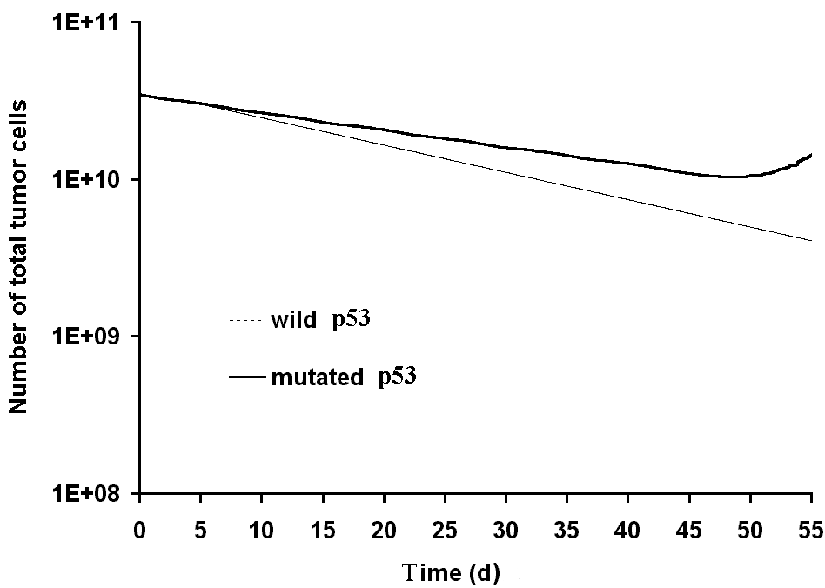
Simulation predictions of the number of total tumour cells (mt p53 and wild type p53) for the standard fractionation scheme. An OER=3.0 has been assumed.
[see V. P Antipas, G. S Stamatakos, N. K Uzunoglu, D. D Dionysiou, R. G Dale, ” A spatio-temporal simulation model of the response of solid tumours to radiotherapy in vivo: parametric validation concerning oxygen enhancement ratio and cell cycle duration,” Phys. Med. Biol. 49 (2004) 1485–1504 [Pubmed Link: http://www.ncbi.nlm.nih.gov/entrez
/query.fcgi?cmd=Retrieve&db=pubmed&dopt=Abstract&list_uids=15152687&query_hl=14] ]

Slide 25
TWO RTOG STUDY 83-02 BRANCHES SIMULATED
1) AHF-48Gy:
accelerated hyperfractionation, 48Gy total dose, (1.6Gy twice daily to a total dose of 48 Gy)
2) HF-81.6Gy:
hyperfractionation, 81.6Gy total dose.(1.2Gy twice daily to a total dose of 81.6Gy)

Slide 26
Number of surviving tumour cells as a function of time for a glioblastoma tumour with mutant p53 gene. AHF-48Gy: accelerated hyperfractionation, 48Gy total dose, HF-81.6Gy: hyperfractionation, 81.6Gy total dose.

Slide 27
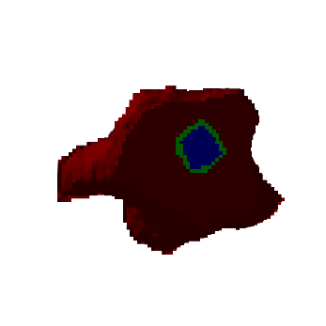
Initial tumour region at the beginning of the radiotherapy treatment

Slide 28
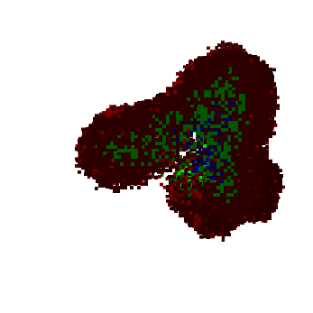
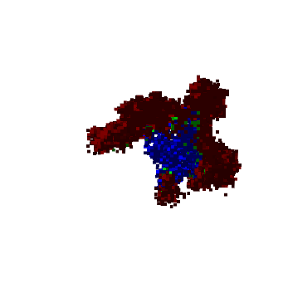
8 weeks later (t=1344h)
Irradiation according to AHF 48Gy
8 weeks later (t=1344h)
Irradiation according to
HF 81.6Gy
Colour code -> red: proliferating cell region, green: G0 cell region, blue: dead cell region

Slide 29
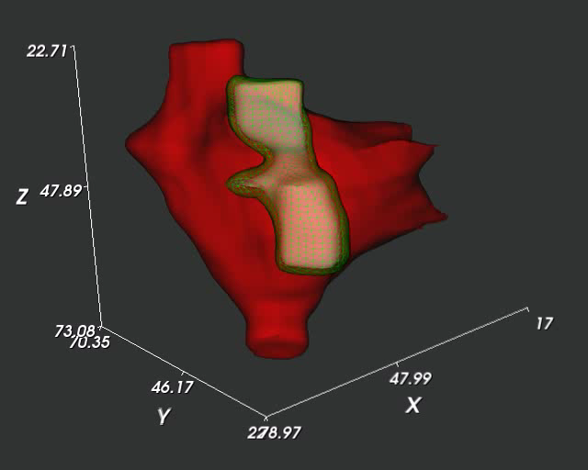

4D (3D + time) visualization
AHF-48Gy
HF-81.6Gy

Slide 30
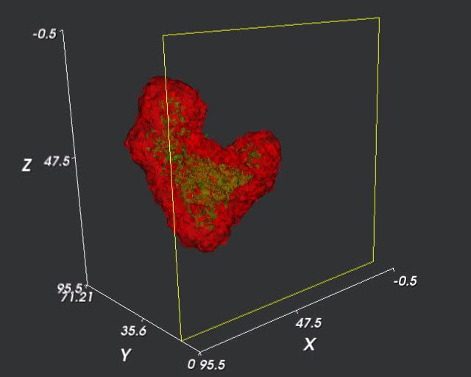
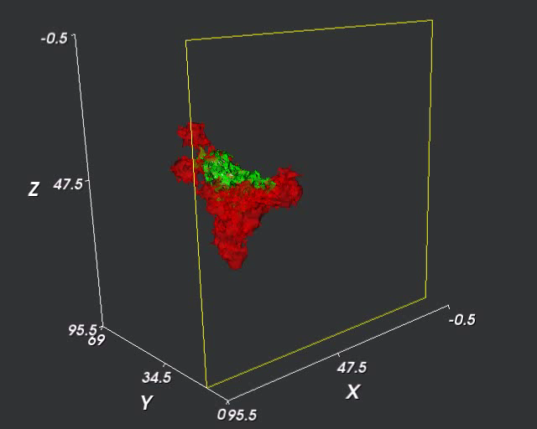
Interactive 2D sampling planes
AHF-48Gy
HF-81.6Gy

Slide 31
Parametric simulation results
Standard fractionation scheme:
2Gy/day, 5 days/week, 60Gy in total, no irradiation during weekends

Slide 32
B. ACGT: BREAST CANCER – FREE GROWTH

Slide 33
Table 1 Model parameter values used in Fig. 4 and Fig.5
Symbol | Description | Value
T_{c} | Cell cycle duration | 30h, 60h, 90h
T_{G1} | Duration of Gap 1 phase | 0.41(T_{c} - T_{M})
T_{S} | Duration of DNA synthesis phase | 0.41(T_{c} - T_{M})
T_{G2} | Duration of Gap 2 phase | 0.18(T_{c} - T_{M})
T_{M} | Duration of mitosis phase | 1h
T_{G0} | Duration of dormant phase | 96h
T_{N} | Time period needed for necrosis’ products to disappear from the tumour | 20h
T_{A} | Time duration needed for apoptosis products to be removed from the tumour | 6h
N_{LIMP} | Number of mitoses performed by progenitor cells before they become differentiated | 7
R_{A} | Apoptosis rate of cancer cells | 0.001 h⁻¹
R_{NDiff} | Necrotic rate of differentiated cells | 0.0001 h⁻¹
R_{ADiff} | Apoptosis rate of differentiated cells | 0.001 h⁻¹
P_{G0toG1} | Fraction of dormant cells that re-enter cell cycle | 0.01
P_{sleep} | Fraction of cells that enter G0 phase following mitosis | 0.2
P_{sym} | Fraction of stem cells that perform symmetric division | 0.3-1

Slide 34
In order to demonstrate the potential of the latest versions of the models the effect of symmetric stem cell division probability on the cellular constitution of an imageable breast cancer tumour has been studied in silico
The diameter of the spherical macroscopically homogeneous tumour has been assumed 12 mm.
A number of code executions have been performed with variable symmetric division probability (or fraction) ranging from 0.3 to 1 and for three values of the cell cycle duration 30h, 60h and 90h.

Slide 35
Cell cycle durations lie within the interval reported in literature
The values of the code input parameters are included in Table 1
Fig. 4 depicts the variation of the relative population of the proliferating stem cells (expressed as a fraction of the total number of cells) as a function of the symmetric division probabily (fraction) for variable cell cycle duration.

Slide 36
Fig. 4. Simulated dependence of the relative proliferating stem cell population on the symmetric division probability (fraction) and the cell cycle duration (Tc)

Slide 37
The graphs reveal that an increase in the parameter Psym leads to an increase in the fraction of the stem cells in the tumour.
This is explained by the fact that more and more stem cells are produced during mitoses
The cell cycle duration appears to play a rather limited role in the dependence under consideration.
However, larger cell cycle durations tend to induce larger relative proliferating stem cell populations within the tumour for a given symmetric division probability (fraction)

Slide 38
Fig. 5. Simulated dependence of the relative proliferating limp (progenitor) cell population on the symmetric division probability (fraction) and the cell cycle duration (Tc)

Slide 39
According to the graphs the fraction of proliferating progenitor (i.e. limp) cells exhibits an initial increase, reaches a maximum and then decreases

Slide 40
POSSIBLE EXPLANATION
Limp (progenitor) cells derive from the asymmetric division of stem cells and their population depends on the product of two competitive factors: the number of stem cells and the asymmetric division fraction
The combination of these two factors leads to the observed behaviour of the limp cell relative population as a function of the symmetric division fraction
An increase of the cell cycle duration leads to an increase of the limp cell category populations as they live for a longer period before they become terminally differentiated

Slide 41
C. ACGT: BREAST CANCER – RESPONSE TO TREATMENT

Slide 42
Therapeutic Scheme Simulated
Epirubicin Dose: 100 mg/m²
Therapeutic scheme:
Bolus administration every 3weeks - repeated 4 times (Administration at times 0 h, 504 h, 1008 h and 1512 h)
AUC: 2/3*0.89 mg*h/L=0.59 mg*h/L
Initial estimate of cell kill ratio: 0.35

Slide 44
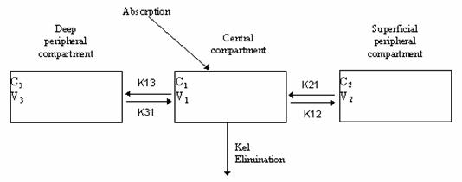
Epirubicin Pharmacokinetics
Pharmacokinetics: C=f(t) → AUC
Epirubicin pharmacokinetics has been described in various studies by an open three-compartment model with elimination from the central compartment
The model permits the estimation of the AUC for any given dose.

Slide 45
Response to Chemotherapy

Slide 46
D. ACGT: NEPHROBLASTOMA – RESPONSE TO TREATMENT

Slide 47
Nephroblastoma Tumour Response to Chemotherapy
The simulation algorithms developed so far address the cases of preoperative chemotherapy for unilateral stage I-III nephroblastoma tumors : combination of actinomycin-D and vincristine according to SIOP 2001/GPOH
SIOP2001/GPOH clinical protocol for Wilm’s tumours.

Slide 48
The Nephroblastoma Case
Treatment Results
Total tumour cell population as a function of time for the chemotherapeutic treatment
Time course of the proliferating (stem and progenitor) and dead cells for the chemotherapeutic treatment
Time course of the differentiated cells for the chemotherapeutic treatment
Time course of the hit cells for the chemotherapeutic treatment

Slide 49
ConclusionS REGARDING THE SIMULATION MODULE
A set of multiscale simulators of cancer dynamics has been briefly outlined
The potential of its top-down architecture for clinical translation has been demonstrated in the context of patient individualized treatment optimization
The capability of the model to simulate strongly discrete dynamical aspects of cancer has been demonstrated i.a. through an indicative study of the effect of symmetric stem cell division probability on the cellular constitution of an imageable breast tumour

Slide 50
Merging of discrete event/state based algorithms with continuous diffusion mathematical treatments, which is in progress within the framework of ContraCancrum , is expected to lead to a more refined simulation platform which will optimally exploit the potential of both discrete and continuous mathematics

Slide 51
THE ACGT ONCOSIMULATOR http://eu-acgt.org/acgt-for-you/researchers/in-silico-oncology.html

Slide 52
Development of the ACGT ONCOSIMULATOR” i.e. a
  clinically meaningful
  scientifically sound
  technologically advanced
  and user friendly
  system able to spatiotemporally simulate tumour growth and normal tissue response to therapeutic schemes
The final goal is to contribute to
  the optimization of cancer therapeutic strategies through conducting in silico (=on the computer) experiments based on the individual patient’s multilevel data
  An additional target is to support the design and interpretation of new clininicogenomic trials

Slide 53
The In Silico Oncology ACGT application
This application utilises patient data from different biocomplexity levels
The constituent simulation models are based on the “top-down” modeling approach
Pertinent clinical, imaging, histopathologic and molecular data in conjunction with the ACGT clinical trials are exploited in order to validate the model both prospectively and retrospectively.
The in silico oncology trial is based on the two ACGT clinical trials (Nephroblastoma SIOP 2001/GPOH and breast cancer TOP trial)

Slide 54
Institutions Participating in the Development and Validation of the ACGT Oncosimulator
ICCS – National Technical University of Athens (Leader)
University of Saarland
University of Hokkaido, Japan
Institut Jules Bordet
Fraunhofer Gesellschaft
INRIA
University of Amsterdam
Poznan Supercomputing Centre
Foundation for Research and Technology – Hellas
Istituto Europeo di Oncologia

Slide 56
TECHNOLOGY MODULES

Slide 57
TECHNOLOGY MODULES
Image Processing
Internal Code Parallelization
Cluster Execution
Grid Execution
Dynamic/Virtual Reality Visualization
Subjunctive Interface Technologies
The overall ACGT technological infrastructure

Slide 58
Need for code execution on Grid environment
Use of Grid architectures is important in order to execute the code for a very large number of parameters values combinations concurrently.
This is necessary in order to increase the reliability of the “Oncosimulator” as many parameter values are not known but only their ranges can be estimated.

Slide 59
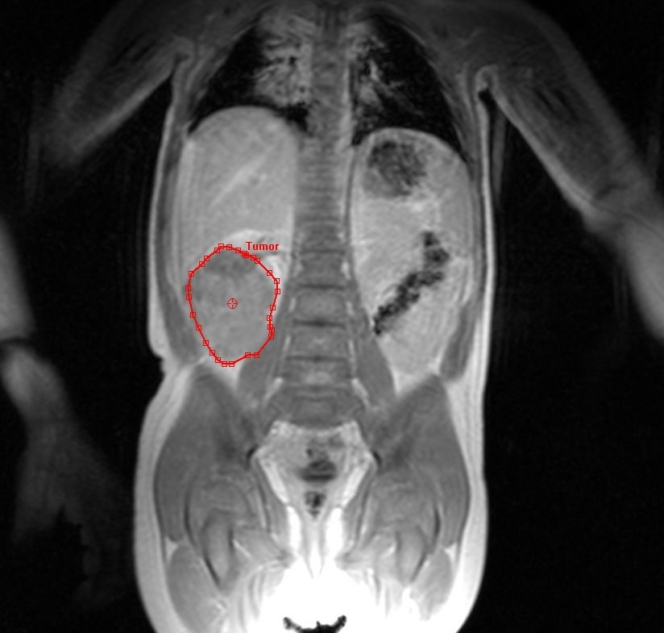
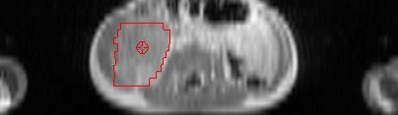
Drawing contours
Contours are drawn slice-wise as a polygon-strip
Notes:
59

Slide 60
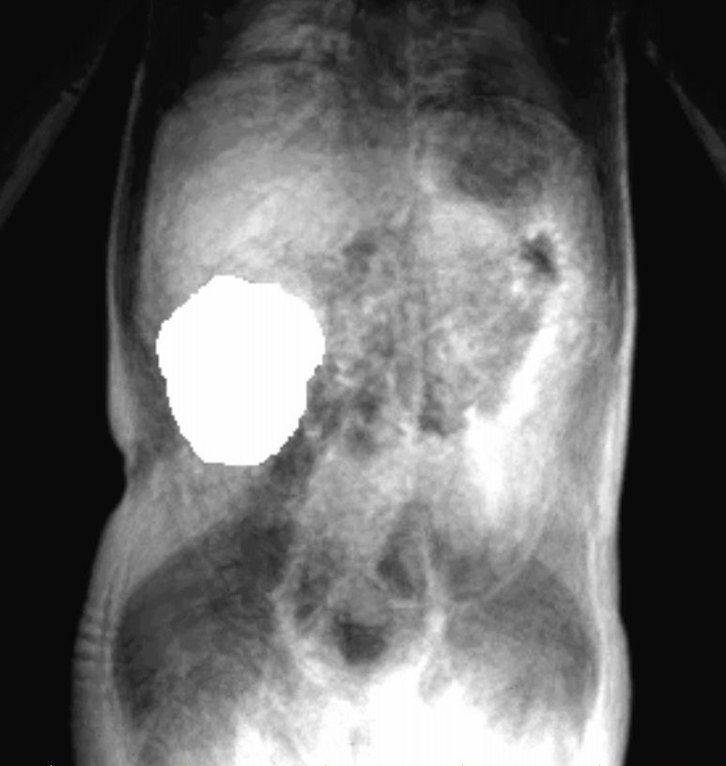
Converting contours to binary data
Scan-line algorithm to fill contour in each slice
Result: binary volume with same dimensions as MRI data set
Notes:
60

Slide 61
Resampling and interpolation of binary segmentations
Using ITK (Insight Segmentation & Registration Toolkit)
Place surface around binary volume
Minimize area of surface using level sets and taking the binary volume as a constraint [1]
Resampling the output (distance transform) to isotropic voxels
Compute zero-level set to recover the surface and to convert it to a binary volume
[1] R. Whitaker. Reducing Aliasing Artifacts in Iso-Surfaces of Binary Volumes. IEEE Volume Visualization and Graphics Symposium, October 2000, pp.23-32.
Notes:
61

Slide 62




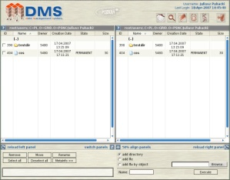
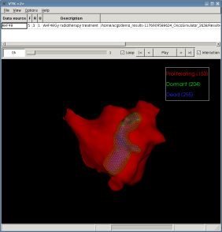
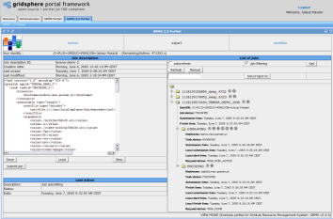

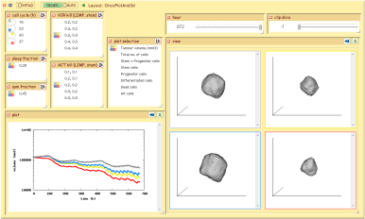
The OncoSimulator Execution Scenario
Segmentation Tool
Grid environment
Visualization
Services
FTP
server
Application portlet
RecipeSheet
Vis. Tools
Notes:
62

Slide 63
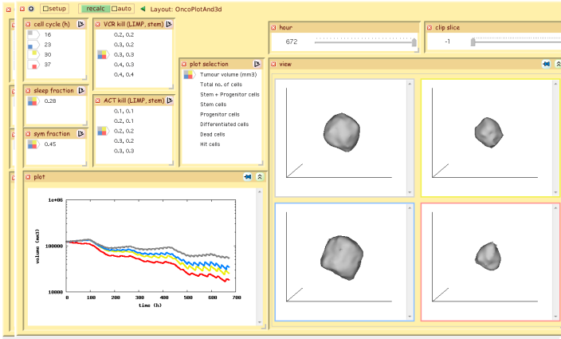
RecipeSheet
Notes:
63

Slide 64
OncoSimulator Component Collaboration Diagram
simulation
parameters
PSNC
1
Grid Resource
Management
System
(GRMS)
3
RecipeSheet/
Web Portal
Simulation
parameters
Job submission
OncoSimulator
Job identifier
Job monitoring
user
2
4
job identifier
vis parameters
…
Reference to:
segmentation
data by
patient id
8
Visualization
parameters
Visualization
services
5
Data request
Images
11
6
9
Segmentation
data
Data requests
References to:
DICOM images
(before/after CT) by patient id
segmentation data by
patient id
(intermediate) oncosimulator
data by job id
7
Data
10
(intermediate)
oncosimulator
data
Data Management
System
(DMS)
Notes:
64

Slide 65
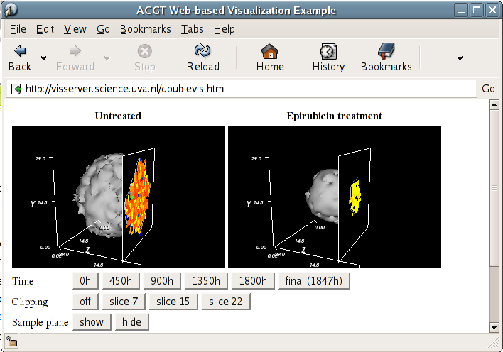
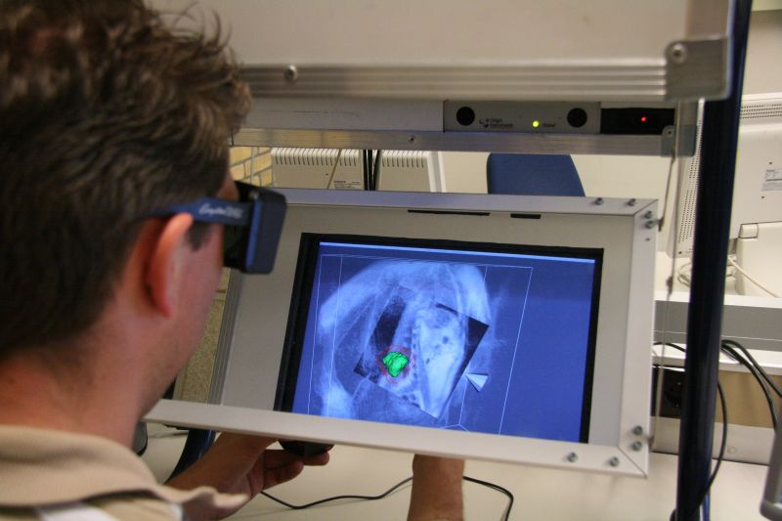
Visualization:
Technical Issues Addressed
Interactive visualization of medical images and OncoSimulator output data
Interactive visualization as a service
used by
  Web based applications (portal)
  RecipeSheet: Parameter-space exploration
  Personal Space Station: “Reach in and touch your data”
Web based visualization
RecipeSheet
Personal Space
Station (PSS)
Notes:
65

Slide 66
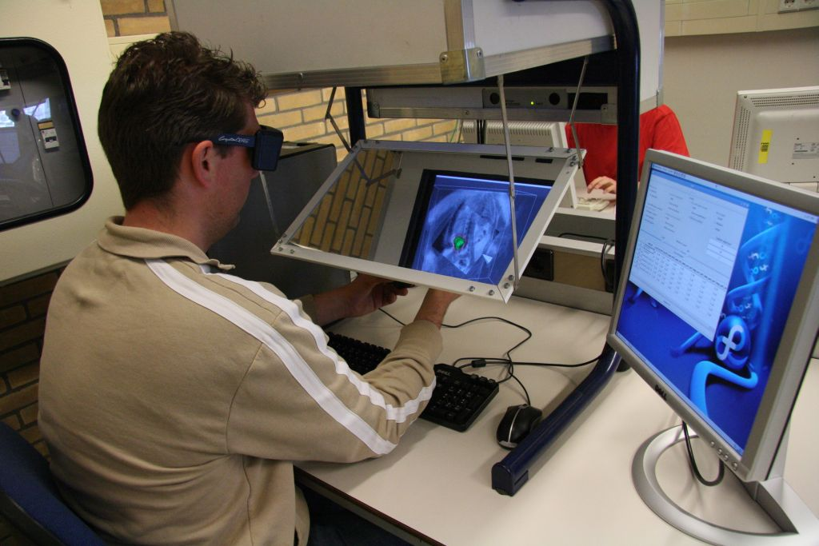
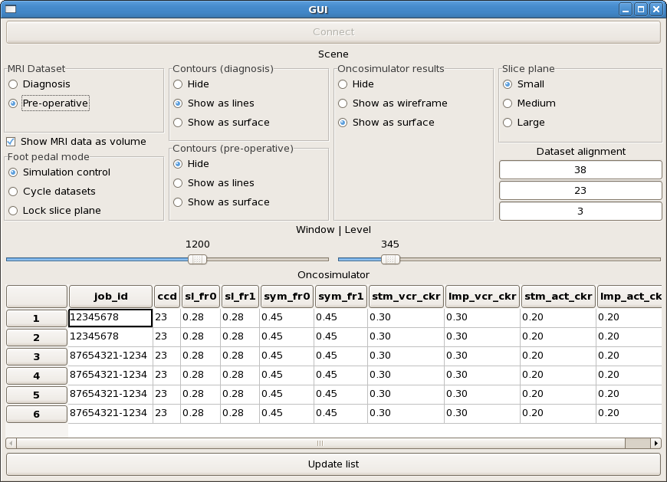
Personal Space Station
Personal Space Station (PSS)
User interface
Personal, interactive graphics device
  3D, stereoscopic visualization
    Motion parallax (virtual reality)
  Camera-based object tracking
    “Reach in and touch your data”
Notes:
66

Slide 67
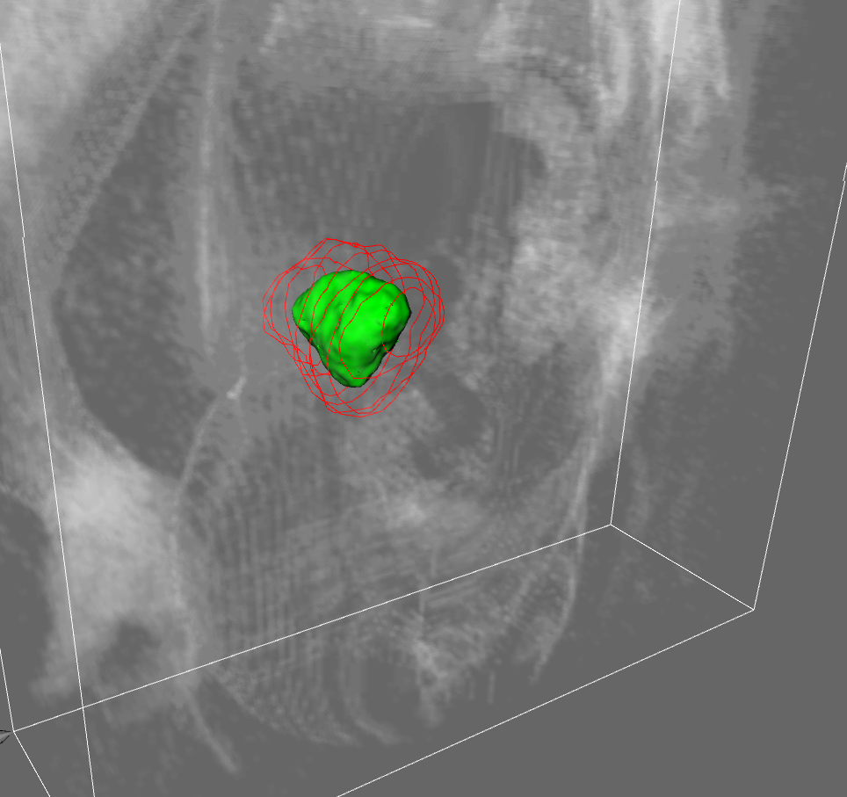
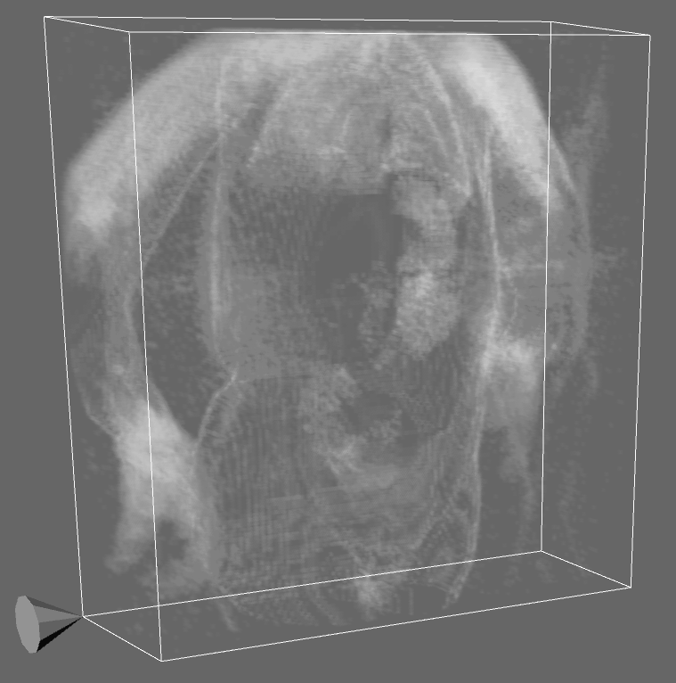
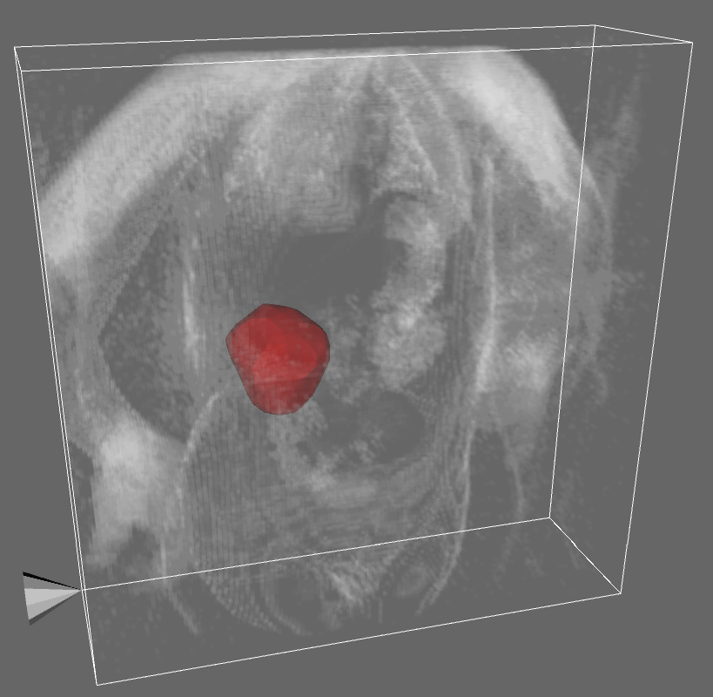
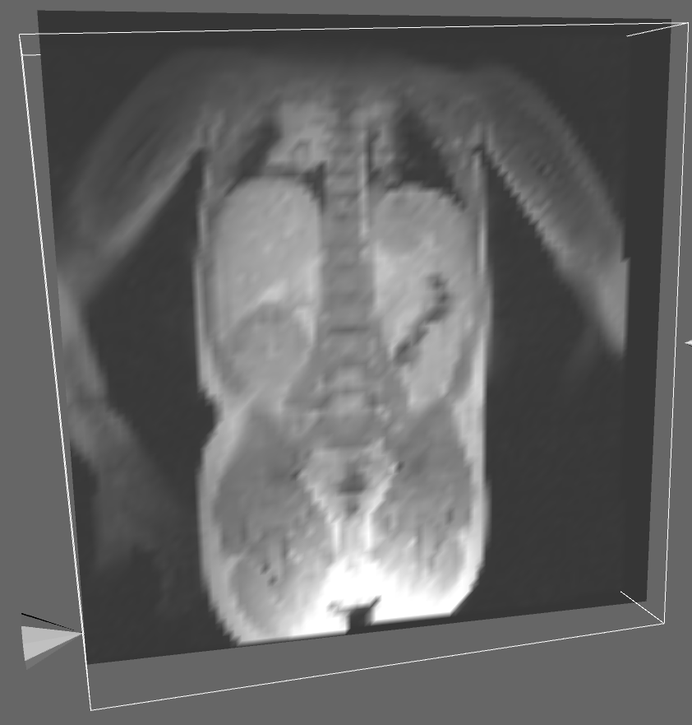
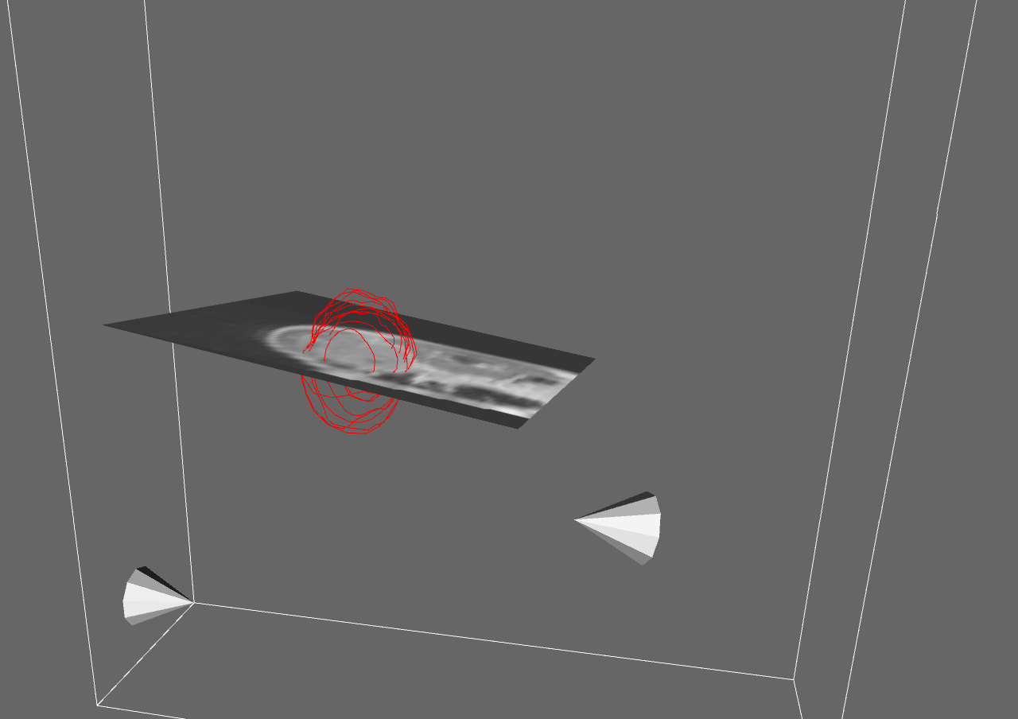
Personal Space Station demonstration
Interactive 3D stereoscopic visualization of one or more of:
  Diagnostic or post-treatment MR image
    Gradient magnitude volume rendering
    Interactive 2D sampling plane
  Diagnostic / post-treatment tumour contours
    Contour lines (drawn by radiologist/oncologist)
    Surface reconstruction
  In silico oncology simulation results
    Animated surface outline of the homogeneous tumour
Notes:
67

Slide 68
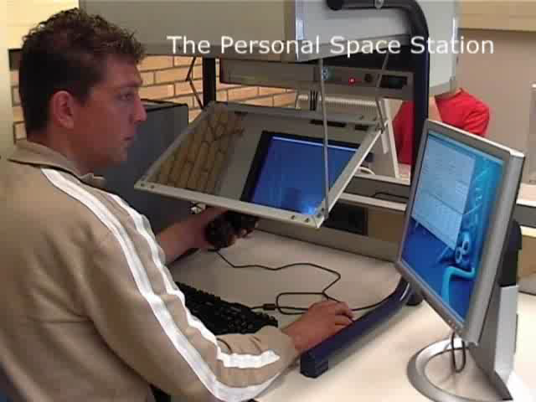
Notes:
68

Slide 69
ConclusionS REGARDING THE composite oncosimulator system
The Oncosimulator is a worlwide novelty pioneering the emergent field of In Silico Oncology
Following clinical validation (currently in progress) it is expected to serve as a pragmatic cancer treatment optimization system in the patient individualized context

Slide 70
The following additional applications are envisaged:
  Support of design and analysis of new clinicogenomic trials
  Education of medical students and interested patients
  Advancement of the Multiscale Physics of Living Matter

Slide 71
In summary the Oncosimulator, just as numerous other systems, techniques, and approaches is expected to contribute to the achievement of
LESS PAIN,
MORE LIFE !

Slide 72

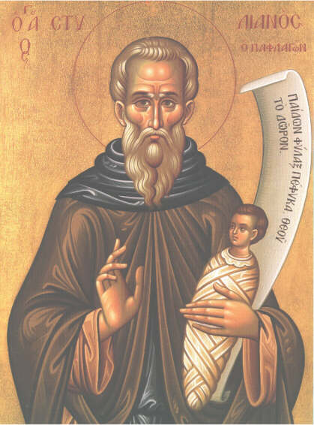

ありがとう Ευχαριστώ
Τhank You
...
...
...
...
Sharing Ideals

